Slide 1
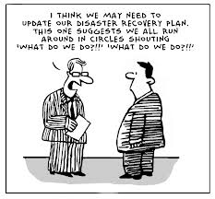

IT2775 Operations Security
BCP: Continuity and Review

Slide 2
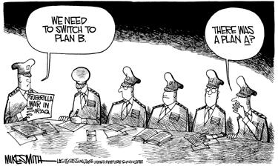
Objectives
P3. Business Continuity Phase (what, when)
  Recovery validation (3 areas)
  Business continuity checklist (3 areas)
P4. Review Phase (why, when)
  BCP Testing
  BCP Audit

Slide 3
P3. Business Continuity Phase
What: Steps to ensure business can operate “normally” are defined.
When: After recovery phase, when effects of disruption had been addressed
It includes …
  Resume operations from a temporary location
  Workarounds to be implemented
  Manual methods to be used during interim period

Slide 4
P3. Business Continuity Phase
Final steps in the phase will address:
  Move back to repaired facility (permanent location)
  Reintegrate or synchronize data
  Transition back to normal operations
Upon returning to the repaired facility, validation of recovery is needed to ensure
  data integrity
  system functionalities

Slide 5
P3. Business Continuity Phase
Recovery Validation
  Data Validation - process of validating recovered data to ensure that they have been recovered completely and are current.
  Functionality Validation - process of validating all system functionalities has been tested and the system is ready to return to normal operations.
  Concurrent Operations - process of concurrently running a system at two separate locations. This is done until we are satisfied that the recovered system is operating correctly and reliably.

Slide 6
P3. Business Continuity Phase
Business Continuity Checklist
  Resuming Operations
    If original location is feasible, resume operations there so that there is no need for an alternate site.
    Ensure IT and other infrastructure are in place.
    Review BCP/DR plan to identify critical business processes which need to be included.
    Review BCP/DR plan to update Maximum Tolerable Downtime (MTD).
    Adjust plans for resuming operations.

Slide 7
P3. Business Continuity Phase
Business Continuity Checklist
  Human resources
    Ensure employees are accounted for.
    Identify personnel issues (medical, insurance) resulting from the disruption.
    Develop status report for crisis management team.
  Insurance and legal
    Review insurance and notify insurance company.
    Conduct assessment of damage.
    Develop status report for CMT.

Slide 8

P4. Review Phase
Why:
  To ensure that BCP is still current and relevant due to changes in the business environment.
When: Business environment changes
  Corporate changes (mergers, restructuring, etc)
  Legal/Regulatory/Compliance changes
  Operations changes
  Technology changes
  Occurs even if BCP is not activated.

Slide 9
P4. Review Phase
Review should include the following:
  Operational, technical and security requirements
  Alternate and offsite facility requirements
  Hardware, software, and other equipment (types, specifications, and amount)
  Contact information of team members (often change due to staff turnover)
  Vendors (include alternate and offsite vendor POCs)
  Vital records (electronic and hardcopy)

Slide 10

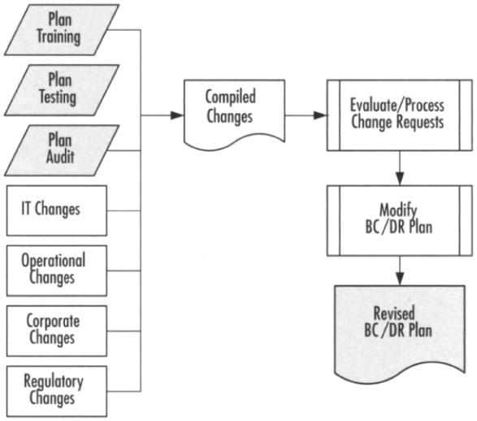
P4. Review Phase
Workflow of BCP Review
Plan, Test, Continue

Slide 11
P4. Review Phase
BCP Testing Objectives
  Check for understanding of processes and procedures.
  Validate the integration of tasks across departments.
  Confirm the steps for each phase of the plan’s execution.
  Determine that right resources have been allocated.
  Familiarize all parties on process and flow of information.
  Identify gaps or weaknesses in the plan.
  Determine cost and feasibility.

Slide 12
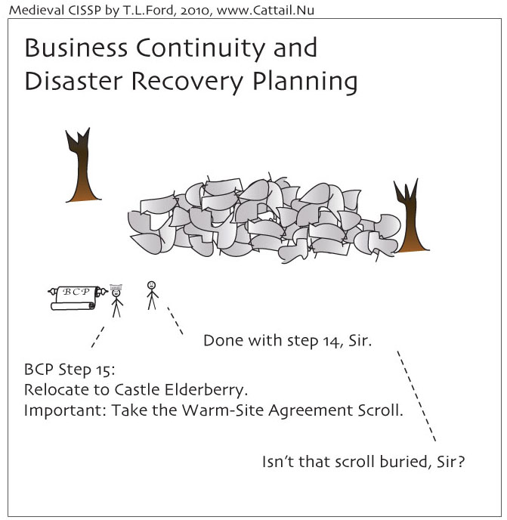
P4. Review Phase
BCP Testing examples
  Notification procedures
  Internal and external connectivity
  Recovery on alternate platform from backup media
  System performance using alternate equipment
  Restoration of normal operations

Slide 13
P4. Review Phase
BCP Audit:
  Auditing is an impartial review to see if the plan meets the overall needs of the organization.
  Auditing a BCP is NOT testing the plan.
  Audit plan should include :
    Audit scope, timeline, requirements and constraints
    Review corporate risks and risk management strategies
    Review business impact
    Review BCP development plan and activities
    Review BCP test plans and activities
    Review BCP training plans and activities
    Review BCP change management, update processes

Slide 14
Summary
P3. Business Continuity Phase (what, when)
  Recovery validation (3 areas)
    Concurrent Ops, Data Validation, Functionality Validation
  Business continuity checklist (3 areas)
    Resuming Ops, Human Resources, Insurance/Legal
P4. Review Phase (why, when)
  BCP Testing
  BCP Audit

